Slide 1


Scrum-agile Effectiveness
A rundown of SNHU Travel project and how well the methods used worked, presented by Joseph Caron
Notes:
Welcome to my presentation on the implementation of the Scrum-agile approach in our SNHU Travel project. Here I’ll be going over how we used these methods to successfully complete this project, how they compare to a more traditional waterfall method, and my recommendation on how to use the various methods moving forward.

Slide 2
Scrum Team Roles
Product Owner: Develops the project goal, create product backlog items, order backlog to maximize business value and communicate all to the rest of the team
Scrum Master: Has the greatest understanding of the Scrum framework and keeps the rest of the development team on track by facilitating smooth workflow.
Developer: Attends daily Scrum meetings, develops the various functions and programs needed to complete the product, ensures the Product Owner and Scrum Master that everything is being completed as planned and provides inputs to the user story creations.
Tester: Collaborates with the Product Owner to clarify user stories, creates test cases for the developed software to ensure functionality and design, and ensures the quality of the product being sold to the customer.
Notes:
Firstly, there are four main roles in an agile scrum team. The different roles are listed here along with their main aspects and responsibilities as they pertained to this project. There are of course other responsibilities not necessarily listed here for brevity, but these are the main foci as they pertained to the project.

Slide 3
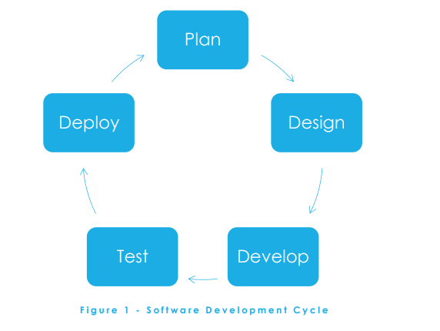
The Software development lifecycle in agile approach
Plan: This phase is where the main idea of the project is created in a very broad scope. The Product owner covers features with the client while leaving details to later.
Design: The details of the project are hashed out in user stories by the product owner. These are then ordered and clarified by the team and placed in a backlog ordered by importance and size.
Develop: The developer(s) begin creating the necessary functions for the project per the user stories during the sprint, following a “just enough” approach to ensure everything is done with minimal time waste. The tester(s) create functionality and design tests for all created functions.
Test: The tester(s) verify that all developed functions pass all tests as required.
Deploy: The created and approved functions for the sprint are implemented, planning for the next sprint begins by cycling back to the Design phase. The cycle repeats until the product is complete.
This Photo by Unknown Author is licensed under CC BY-SA
Notes:
The total software development lifecycle follow much the same pattern in agile as it does with a waterfall method, however it is usually smaller in scope, focusing more on shorter, quicker development cycles called sprints. Sprints are typically only a few weeks long and focus on only a portion of the total functions required by the client. The main difference is that in an agile development, the lifecycle circles back on itself continuously until project completion rather than running through a single time.

Slide 4
Agile vs. Waterfall
Agile
Waterfall
Allows for later changes
Faster mitigation of problems
More uncertainty in time and cost estimates
Overall more flexibility
Plan set at the beginning and unchanged
Problems can cause major delays
Lower focus on communication can cause inter-dependability issues
More structured estimates
“To summarize, Agile and Waterfall are two different management methodologies best suited for different types of projects” (Bottorff & Hoory, 2022)
Notes:
As a specific example of how this project would have differed if run in a traditional waterfall methodology: near the end of the project, the client requested a major change to a requirement. It caused no time delays, but did require some rework to almost completed functions. In a waterfall method, such a change wouldn’t be possible. There would be no rework specific to this function, however the client may have been left unsatisfied because the change couldn’t be implemented.

Slide 5
Agile or Waterfall, when to choose
How much flexibility will be needed?
How familiar is the team with agile?
What is the relationship with the customer?
“There is no "right answer" when deciding between the two approaches—it depends on your team and project” (Cargopoulos, 2021)
Notes:
The three main factors to look at when choosing a method to work with are how certain the requirements of the project are, how comfortable the team is with agile and each other, and what kind of customer relationship there is. The more uncertainty in a project, the more flexibility will be needed. If a team is not familiar with agile, they may have trouble in an agile methodology project. In a contractual relationship, requirements are set and laid out up front, decreasing uncertainty in a project. All of these points should be considered closely when deciding on which approach to use on a project. Thank you.

Slide 6
References
Bottorff, C. & Hoory, L. (2022, Aug 10). Agile Vs. Waterfall: Which Project Management Methodology Is Best For You? Forbes. https://www.forbes.com/advisor/business/agile-vs-waterfall-methodology
Cargopoulos, G. (2021, Sep 19). Agile vs. Waterfall: What Should You Use for Your Project? Withintent. https://www.withintent.com/blog/agile-vs-waterfall
SDLC Phases [Infographic]. (2023, May 5). Geektonight. https://www.geektonight.com/software-development-life-cycle-sdlc/

